Slide 1
INTRODUCTION
GREETINGS
CLOSING

Slide 2
GREETINGS
INTRODUCTION
CLOSING
Hi, Rain.
I wanted to do something special for you.

Slide 3
INTRODUCTION
GREETINGS
CLOSING
Happy 20th Birthday ✨
A small celebration for someone wonderful.

Slide 4
INTRODUCTION
GREETINGS
CLOSING
20
A beautiful age
A gentle beginning
A year meant for you

Slide 5
INTRODUCTION
GREETINGS
CLOSING
There’s something about you…
The way you smile
The way you laugh
The calm you bring without trying

Slide 6
INTRODUCTION
GREETINGS
CLOSING
On your birthday, I hope you feel…
Appreciated
Celebrated
And quietly happy

Slide 7
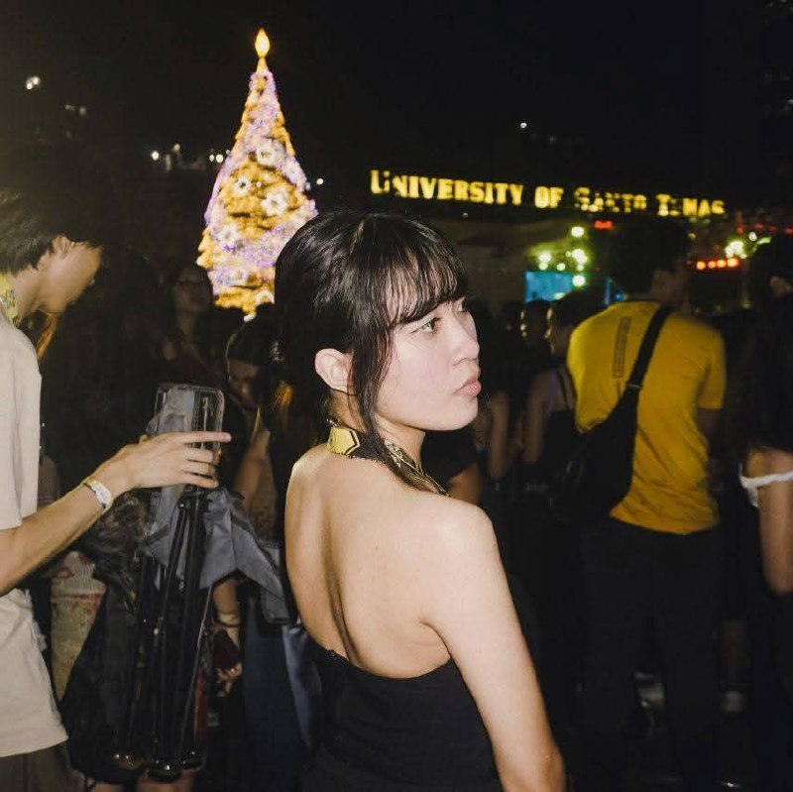
INTRODUCTION
GREETINGS
CLOSING
This moment
Feels like you—soft and warm

Slide 8
INTRODUCTION
GREETINGS
CLOSING
I wish you days
That feel light
Nights that feel peaceful
And dreams that slowly come true

Slide 9
INTRODUCTION
GREETINGS
CLOSING
I’m thankful
I get to know you
And I’m glad I get to celebrate you today

Slide 10
INTRODUCTION
GREETINGS
CLOSING
Choose one
Me or Me You can just message the answer later 😉

Slide 11
GREETINGS
CLOSING
INTRODUCTION
Anyways kidding aside
Happy Birthday, Rain 🤍
You deserve every good thing today

